Slide 1

Med Tracker
Iteration 1
CS 673 Team 1 Andrew Gieraltowski, Divya Thomas, Yuan Wang, Haiyang Lu

Slide 2
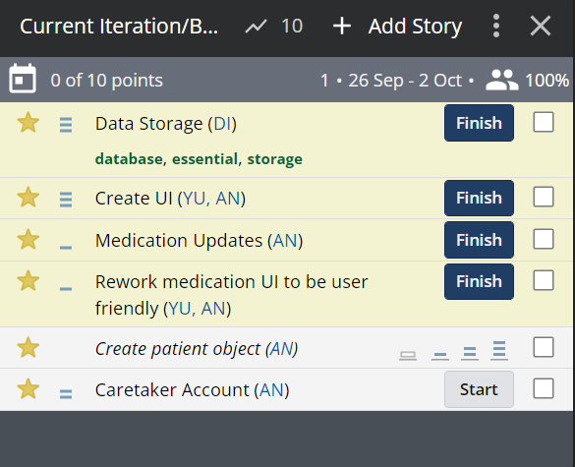
Iteration Plan

Slide 3
Deliverables
Data Storage
Press add button to call database
Detail description & image storage
Save medication button
Access medication in homepage from database

Slide 4
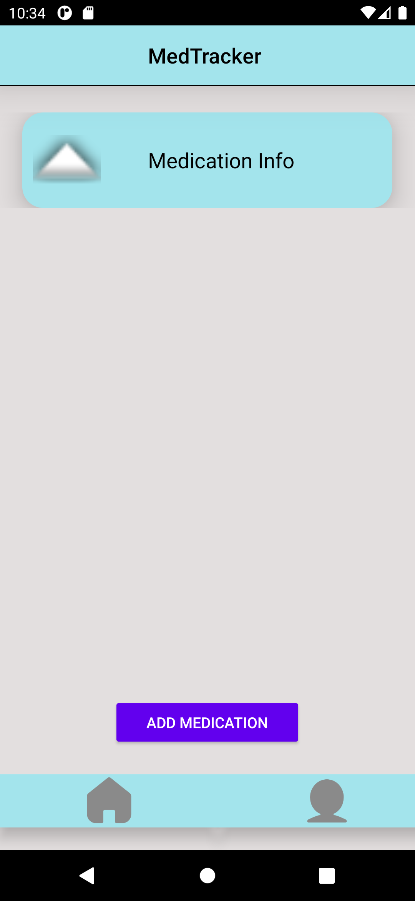
Deliverables
Homepage UI
Add medication button
Taskbar created
Medication Information display
User friendly for elders

Slide 5
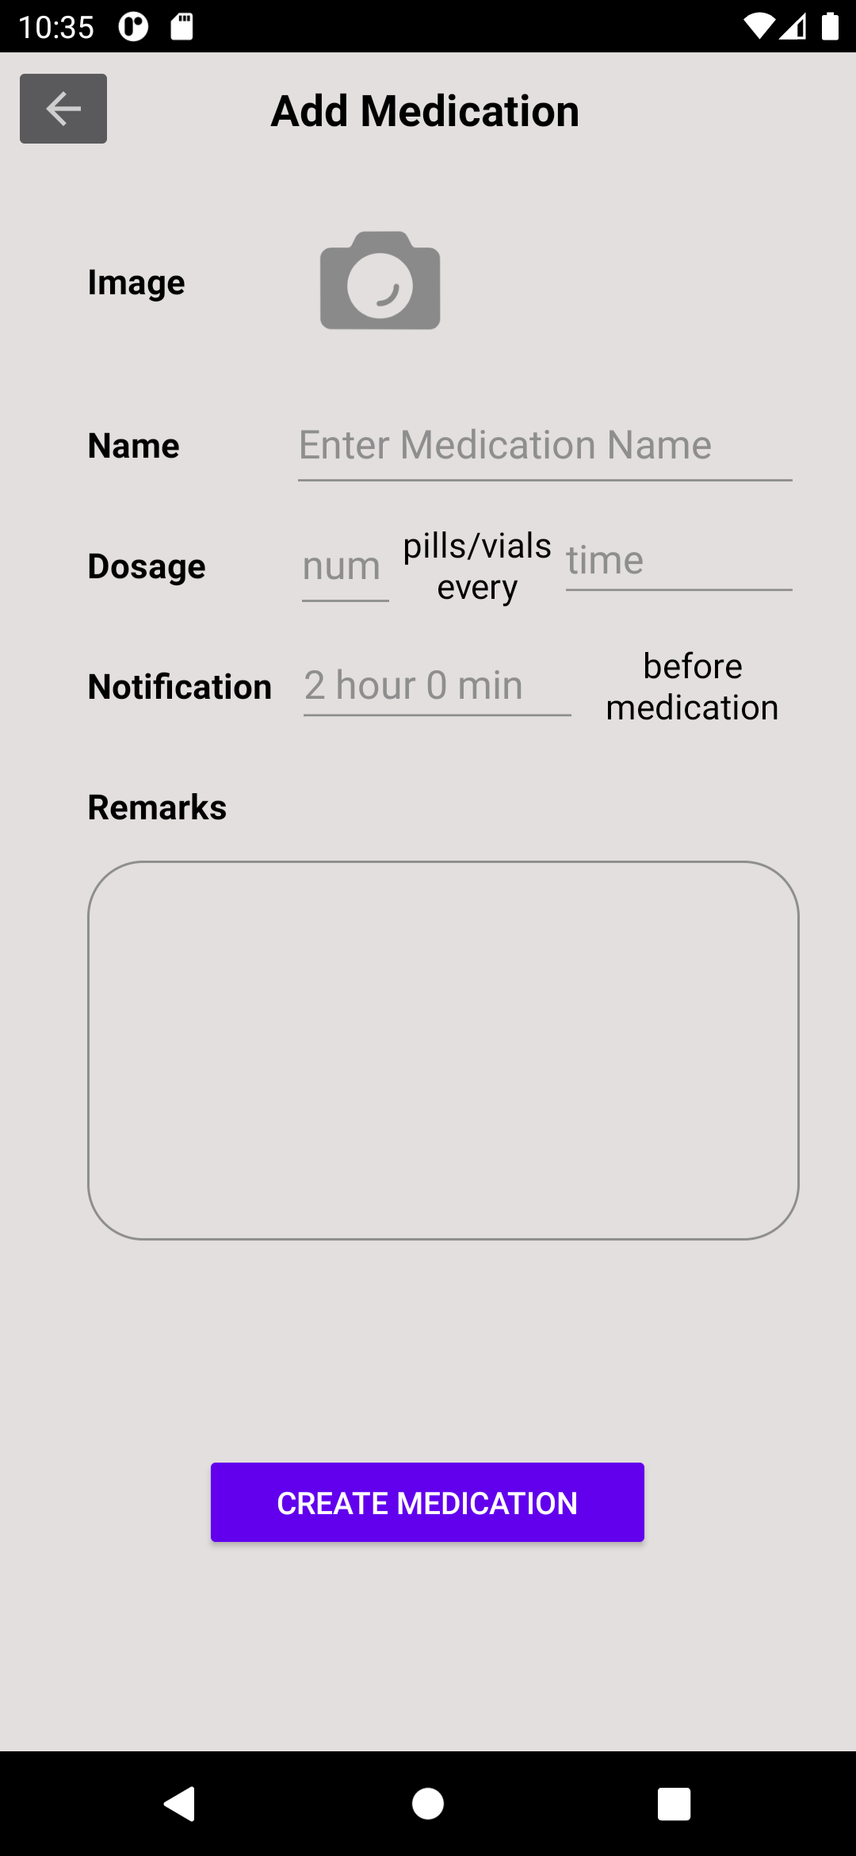
Deliverables
Create UI for add medication page
Upload images for medication
Input Medication description
Notification setup
Create medication button

Slide 6
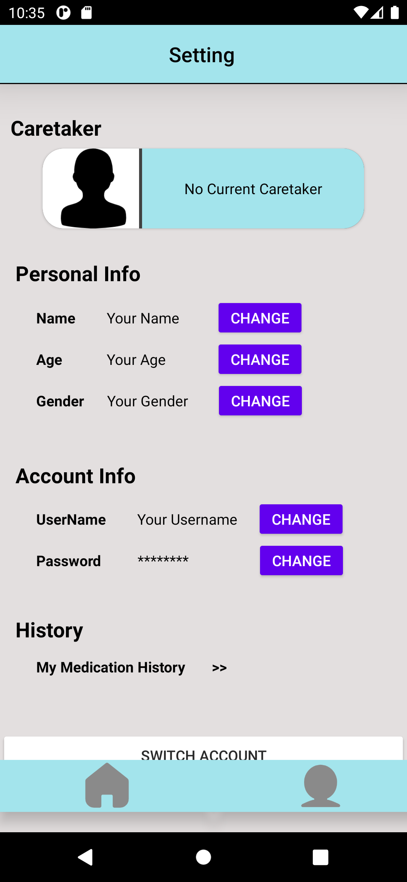
Deliverables
Setting Page UI
Personal info
Name
Age
Gender
History
Track user history
Account info
Username
Password
Switch account button
Name
Age
Gender

Slide 7
Main Decisions
Determine and setup developing environment & functional features
Create UI for homepage, medication and setting page
Database setup
Documentation Submission
Update the project to Github
Assign research tasks for future iteration

Slide 8
Thank you!

